Slide 1
Theory of Automata
Lecture # 17
Dr. Muhammad Fayaz

Slide 2


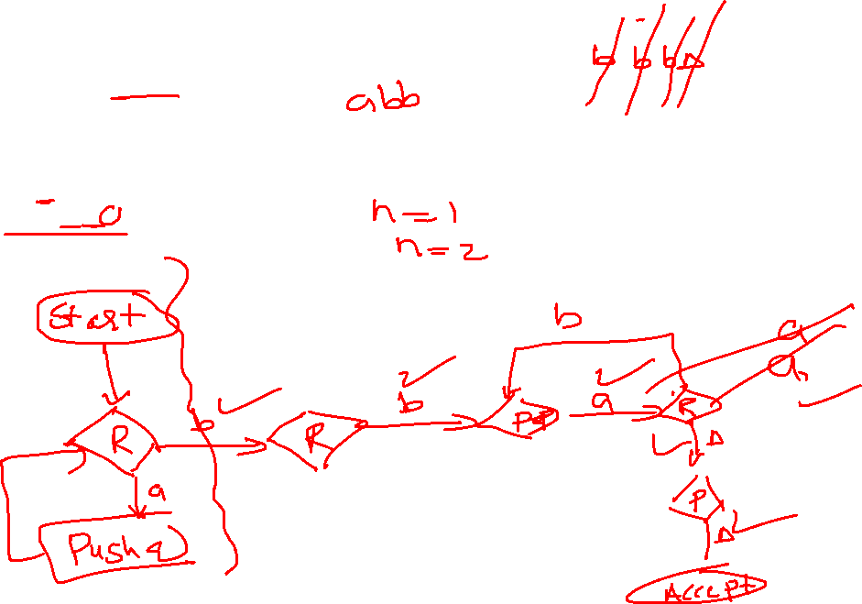
PDA for a^{n}b^{n+1}
Input Tape
 |  |  |  |  |  |  |  |  | ∆
$$\{n≥1 \}$$
1. Push all a’s in stack
2. Compare a’s one by one in stack with b’s in the tape and delete a’s as well as b’s
∆
$$\{abb, aabbb, aaabbbb, ………\}$$
Stack

Slide 3


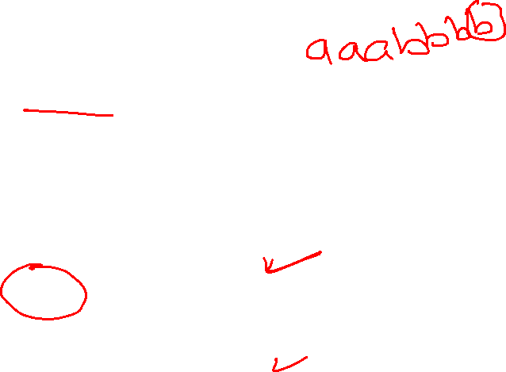
PDA for a^{n}b^{n+1}
Input Tape
 |  |  |  |  |  |  |  |  | ∆
$$\{n≥1 \}$$
1. Push all a’s in stack
∆
2. Compare a’s one by one in stack with b’s in the tape and delete a’s as well as b’s
$$\{abb, aabbb, aaabbbb, ………\}$$
Stack

Slide 4


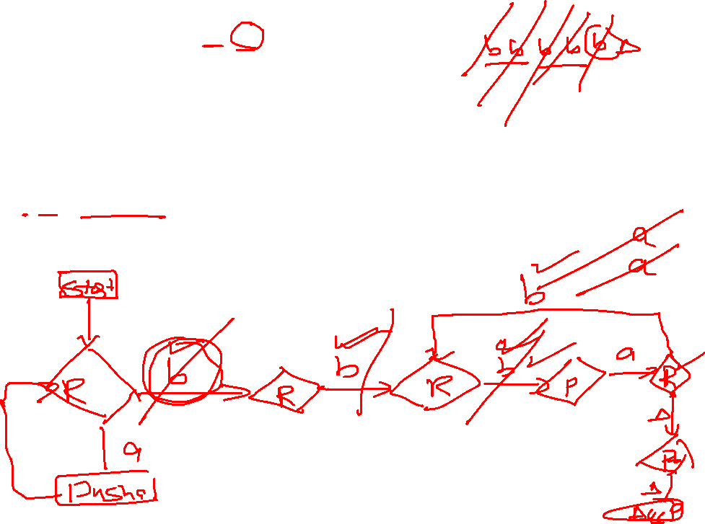
PDA for a^{n}b^{2n+1}
$$\{n≥1 \}$$
 |  |  |  |  |  |  |  |  | ∆
1. Push all a’s in stack
∆
2. Compare a’s one by one in stack with b’s in the tape and delete a’s as well as b’s
$$\{abbb, aabbbbb, aaabbbbbbb,……\}$$

Slide 5
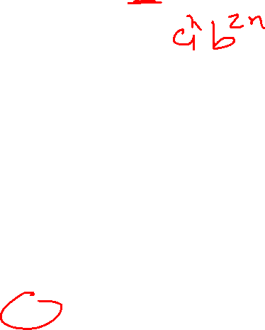
PDA for a^{n}b^{2n+1}
$$\{n≥1 \}$$
 |  |  |  |  |  |  |  |  | ∆
1. Push all a’s in stack
∆
2. Compare a’s one by one in stack with b’s in the tape and delete a’s as well as b’s
$$\{abbb, aabbbbb, aaabbbbbbb,……\}$$

Slide 6


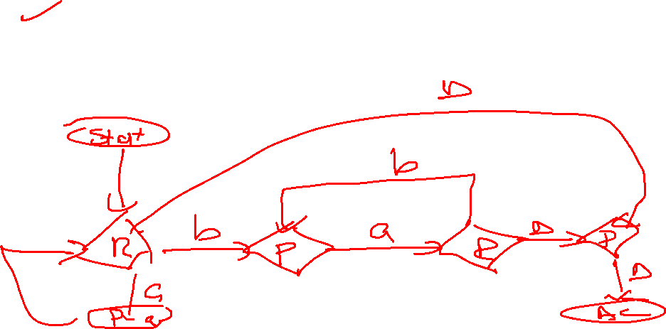
PDA for a^{n}b^{n}
Input Tape
∆
 |  |  |  |  |  |  |  |  | ∆
$$\{n≥0 \}$$
1. Push all a’s in stack
2. Compare a’s one by one in stack with b’s in the tape and delete a’s as well as b’s
$$\{∆,ab, aabb, aaabbb, ………\}$$
Stack

Slide 7
PDA for a^{n}b^{n}
Input Tape
∆
 |  |  |  |  |  |  |  |  | ∆
$$\{n≥0 \}$$
1. Push all a’s in stack
2. Compare a’s one by one in stack with b’s in the tape and delete a’s as well as b’s
$$\{∆,ab, aabb, aaabbb, ………\}$$
Stack

Slide 8


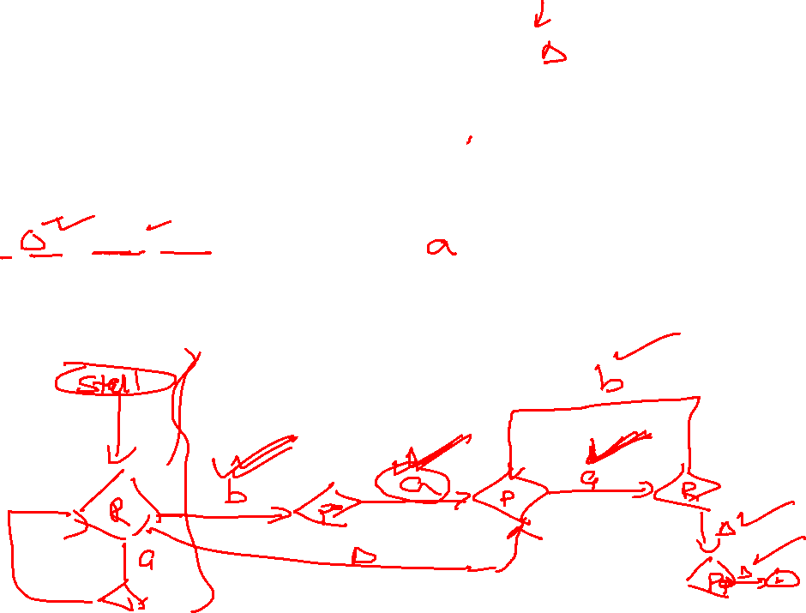
PDA for a^{n}b^{n-1}
Input Tape
∆
 |  |  |  |  |  |  |  |  | ∆
$$\{n≥1 \}$$
1. Push all a’s in stack
2. Compare a’s one by one in stack with b’s in the tape and delete a’s as well as b’s
$$\{a,aab, aaabb, aaaabbb, ………\}$$
Stack

Slide 9
PDA for a^{n}b^{n-1}
Input Tape
∆
 |  |  |  |  |  |  |  |  | ∆
$$\{n≥1 \}$$
1. Push all a’s in stack
2. Compare a’s one by one in stack with b’s in the tape and delete a’s as well as b’s
$$\{a,aab, aaabb, aaaabbb, ………\}$$
Stack

Slide 10
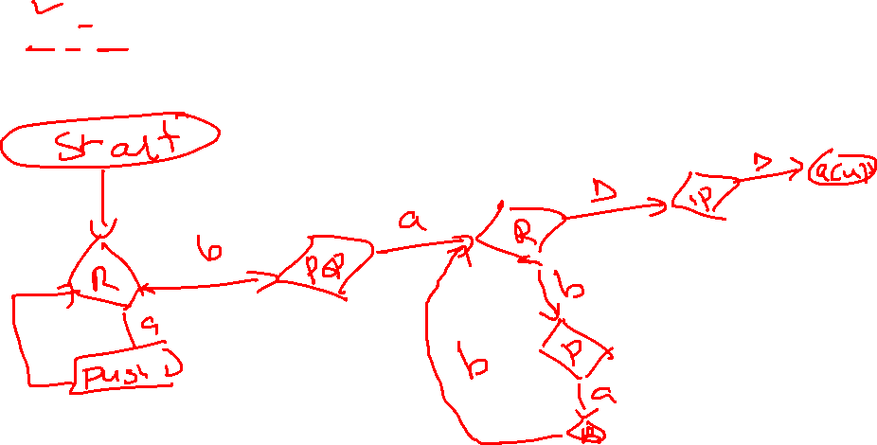


PDA for a^{n}b^{2n-1}
$$\{n≥1 \}$$
∆
 |  |  |  |  |  |  |  |  | ∆
1. Push a letters to stack
2. Compare ‘a’ letters one by one in stack with ‘b’ letters in tape and delete
$$\{ab,aabbb, aaabbbbb, ………\}$$

Slide 11
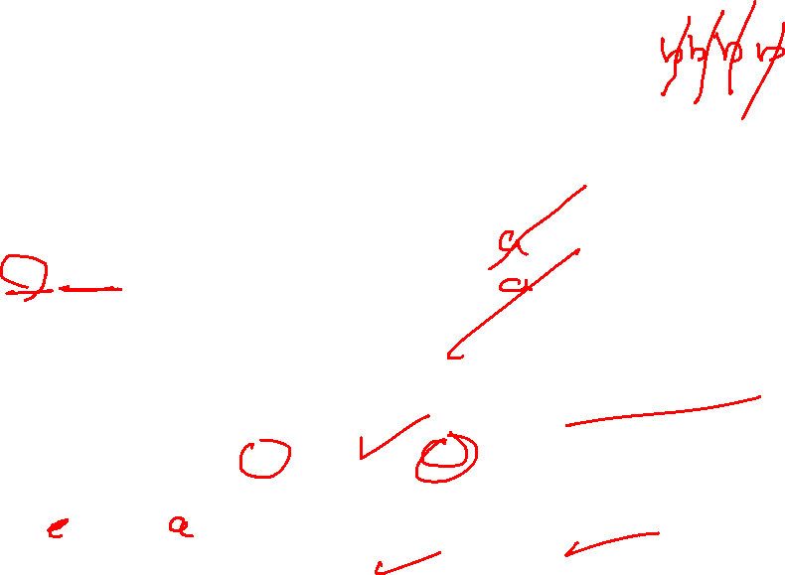
PDA for a^{n}b^{2n-1}
$$\{n≥1 \}$$
∆
 |  |  |  |  |  |  |  |  | ∆
1. Push a letters to stack
2. Compare ‘a’ letters one by one in stack with ‘b’ letters in tape and delete
$$\{ab,aabbb, aaabbbbb, ………\}$$

Slide 12
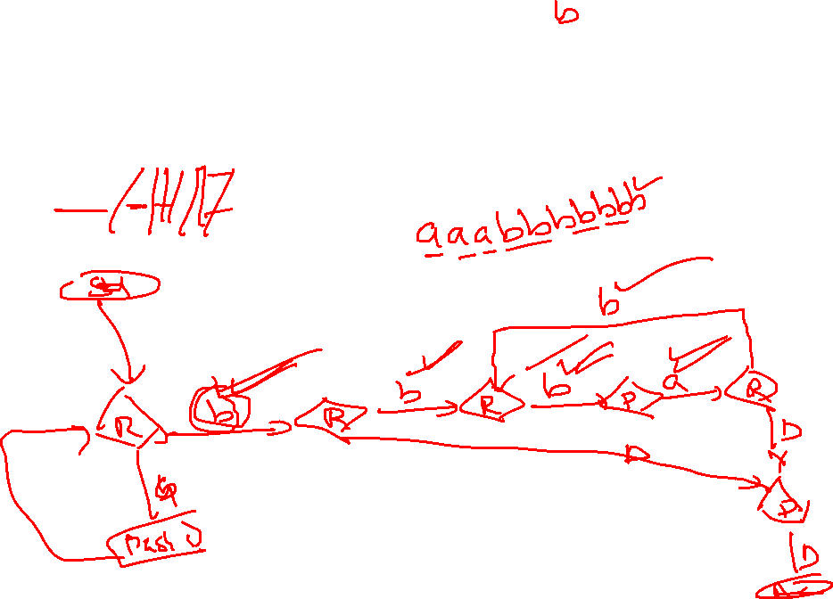


PDA for a^{n-1}b^{2n-1}
$$\{n≥1 \}$$
 |  |  |  |  |  |  |  |  | ∆
∆
1. Push ‘a’ letters to stack
2. Compare ‘a’ letters one by one in stack with ‘b’ letters in tape and delete
$$\{b,abbb, aabbbbb, ………\}$$

Slide 13
PDA for a^{n-1}b^{2n-1}
$$\{n≥1 \}$$
 |  |  |  |  |  |  |  |  | ∆
∆
1. Push ‘a’ letters to stack
2. Compare ‘a’ letters one by one in stack with ‘b’ letters in tape and delete
$$\{b,abbb, aabbbbb, ………\}$$

Slide 14
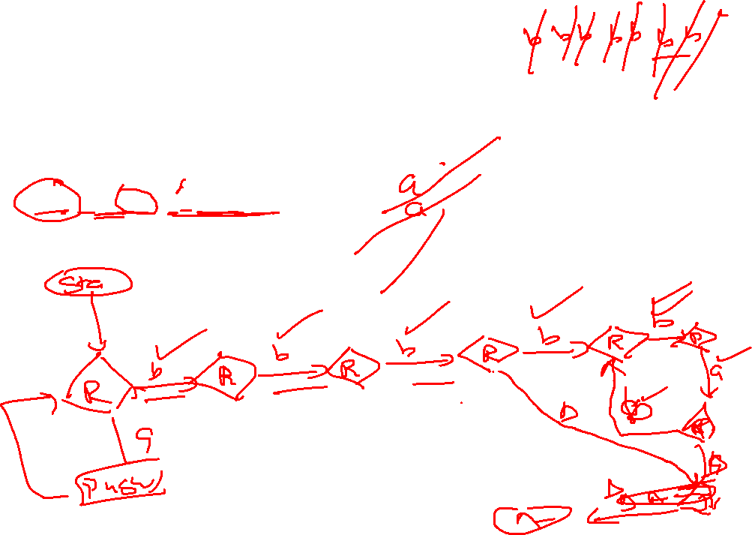

PDA for a^{n-1}b^{2n+1}
$$\{n≥1 \}$$
∆
 |  |  |  |  |  |  |  |  | ∆
1. Push a letters to stack
2. Compare ‘a’ letters one by one in stack with ‘b’ letters in tape and delete
$$\{bbb,abbbbb, aabbbbbbb, ………\}$$

Slide 15
PDA for a^{n-1}b^{2n+1}
$$\{n≥1 \}$$
∆
 |  |  |  |  |  |  |  |  | ∆
1. Push a letters to stack
2. Compare ‘a’ letters one by one in stack with ‘b’ letters in tape and delete
$$\{bbb,abbbbb, aabbbbbbb, ………\}$$

Slide 16


PDA for a^{n-1}b^{n-1}
Input Tape
$$\{n≥1 \}$$
∆
 |  |  |  |  |  |  |  |  | ∆
1. Push a letters to stack
2. Compare ‘a’ letters one by one in stack with ‘b’ letters in tape and delete
$$\{∆, ab, aabb, aaabbb………\}$$
Stack

Slide 17
PDA for a^{n-1}b^{n-1}
Input Tape
$$\{n≥1 \}$$
∆
 |  |  |  |  |  |  |  |  | ∆
1. Push a letters to stack
2. Compare ‘a’ letters one by one in stack with ‘b’ letters in tape and delete
$$\{∆, ab, aabb, aaabbb………\}$$
Stack

Slide 18

PDA for a^{n+1}b^{n-1}
Input Tape
$$\{n≥1 \}$$
∆
 |  |  |  |  |  |  |  |  | ∆
1. Push a letters to stack
2. Compare ‘a’ letters one by one in stack with ‘b’ letters in tape and delete
$$\{aa, aaab, aaaabb, ………\}$$
Stack

Slide 19
PDA for a^{n+1}b^{n-1}
Input Tape
$$\{n≥1 \}$$
∆
 |  |  |  |  |  |  |  |  | ∆
1. Push a letters to stack
2. Compare ‘a’ letters one by one in stack with ‘b’ letters in tape and delete
$$\{aa, aaab, aaaabb, ………\}$$
Stack

Slide 20


PDA for a^{n+2}b^{n-1}
Input Tape
$$\{n≥1 \}$$
∆
 |  |  |  |  |  |  |  |  | ∆
1. Push a letters to stack
2. Compare ‘a’ letters one by one in stack with ‘b’ letters in tape and delete
$$\{aaa, aaaab, aaaaabb, ………\}$$
Stack

Slide 21
PDA for a^{n+2}b^{n-1}
Input Tape
$$\{n≥1 \}$$
∆
 |  |  |  |  |  |  |  |  | ∆
1. Push a letters to stack
2. Compare ‘a’ letters one by one in stack with ‘b’ letters in tape and delete
$$\{aaa, aaaab, aaaaabb, ………\}$$
Stack

Slide 22


PDA for a^{2n-1}b^{2n-1}
Input Tape
$$\{n≥1 \}$$
∆
 |  |  |  |  |  |  |  |  | ∆
1. Push a letters to stack
2. Compare ‘a’ letters one by one in stack with ‘b’ letters in tape and delete
$$\{ ab, aaabbb, aaaaabbbbb………\}$$
Stack

Slide 23
PDA for a^{2n-1}b^{2n-1}
Input Tape
$$\{n≥1 \}$$
∆
 |  |  |  |  |  |  |  |  | ∆
1. Push a letters to stack
2. Compare ‘a’ letters one by one in stack with ‘b’ letters in tape and delete
$$\{ ab, aaabbb, aaaaabbbbb………\}$$
Stack

Slide 24
THANKS

